Slide 1
Poetic Elements
Essential Question: What are the characteristics of poetry and how and why do poets use them?

Slide 2
What is poetry?
Use of language, imagery, and rhythm to express emotion
Written in verse: writing arranged with a metrical rhythm, typically having a rhyme.
(prose: no regular rhythm or rhyme, follows grammar rules)

Slide 3
Figures of Speech
A Comparison for both fun and purpose

Slide 4
figure of Speech/Figurative language
Expressions that put aside literal meanings in favor of using imaginative comparisons
Always based on comparisons – not literally true
Example: “You are on fire!” and “I laughed so hard I…”
Literal – true and meant to be taken as true
Figurative – not true and not meant to be taken as true

Slide 5
recap
Metaphor
Simile
Personification
Hyperbole
Allusion
Onomatopoeia
Symbol
Alliteration
Irony
Pun
Idiom

Slide 6
What are Speaker and Voice?
The speaker is the voice talking to us in a poem
It is not necessarily the poet.
The speaker may take on a persona or a mask
May become a different sex or age or personality
The voice is the speaker’s tone and his/her style of writing
Voice = tone + style
Voice = attitude + word choice, poem type, sentence structure, placement of words on the page, etc.
How would you describe your voice?

Slide 7
Tone and Mood
Tone: The attitude the speaker expresses towards the subject or audience
Mood: The feeling a poem creates through word choice

Slide 8
What are the Forms of Poetry?
Lyric poem: expresses emotion, does not tell a story, usually short
Blank verse: regular rhythm, no rhyme
Free verse: no rhyme but has rhythm, used to imitate everyday speech
Haiku: from Japan, only has 3 lines (5, 7, 5 syllables), focuses on nature
Sonnet: 14 line lyric poem with alternating rhyme scheme (ABAB, BCBC, etc.)
Ballad/Epic: tells a story

Slide 9
Rhythm and Rhyme
How is sound used in poetry, and why do poets use it?

Slide 10
What is Rhythm?
What is the rhythm that everyone carries around with them every day?
Rhythm is a musical quality based on repetition of stressed syllables
A strong regular repeated pattern of movement or sound
Are there any beatboxers in the house?

Slide 11
What is Rhyme?
Not as obvious as you might think
Rhyme is the repetition of the sound of the stressed vowel and any sounds that follow it in words that are close together
Nails and whales
Material and cereal
Icicle and bicycle
Approximate rhyme
Words that repeat some sounds but are not exact echoes
Also known as half rhymes, off rhymes, slant rhymes

Slide 12
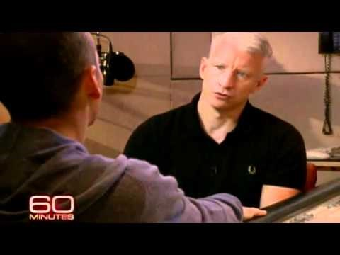
What Rhymes with Orange?

Slide 13
Rhyme, continued
End rhyme
Rhymes that occur at the end of lines
Examples
Write one
Internal rhyme
Rhymes that occur inside the lines
“Ah distinctly I remember it was in the bleak December and each separate dying ember wrought its ghost upon the floor” – Poe
Write one
Rhyme scheme – a regular pattern of end rhyme which defines the shape of a poem and holds it together
What is the rhyme scheme of “Still I Rise”?

Slide 14
What is Repetition?
A phrase, stanza, or word that is repeated throughout the work to clearly establish something important
At the end of a verse, or not.
“this morning
this morning
i met myself
coming in”
- Clifton
Common in music in the form of a refrain or chorus
Why do poets use repetition?
To make a point, to make a rhythm, pattern, beat

Slide 15
What is Theme?
Start with the question, “Why did the poet write this poem?” and go from there.
Theme indicates the message the poet is trying to communicate
Can answer the questions:
“What is the poem trying to say?”
“What’s the point?”
“What message am I getting from this?”
Theme is never one word. It is always a complete sentence. Topic is one word.
Example: Sometimes, as horrible as it may be, death is unexplainable.

